Slide 1
Cervical Pathology

Slide 2
Objectives
At the end of this lecture you should be able to
Describe the pathogenesis of human papilloma virus (HPV) related premalignant and malignant lesions of the cervix
Describe the microscopy of dysplasia of the cervix
Describe the morphology of carcinoma of the cervix
Briefly describe the non-neoplastic conditions of the cervix

Slide 3
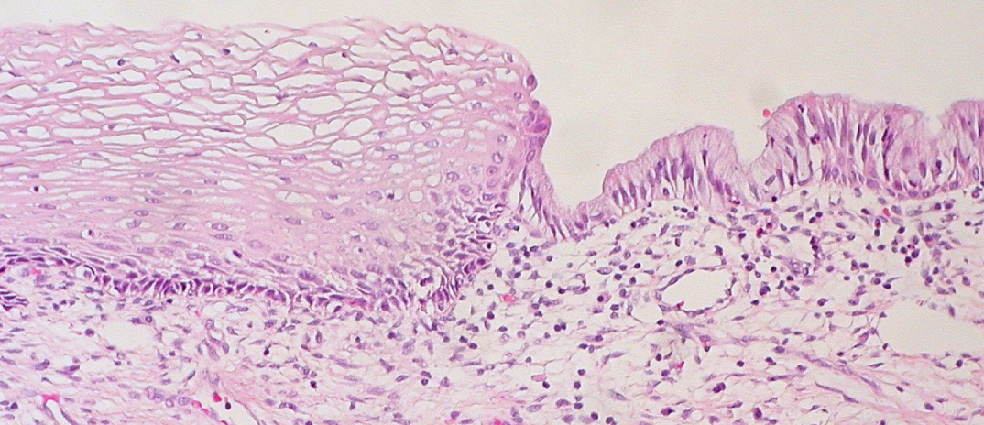
Squamo-columnar transformation zone of the cervix
Squamous epithelium
Columnar epithelium
Squamo- columnar junction
Location of squamo-columnar junction in relation to the external os varies with the age, menstrual status, pregnancy and with OCP

Slide 4
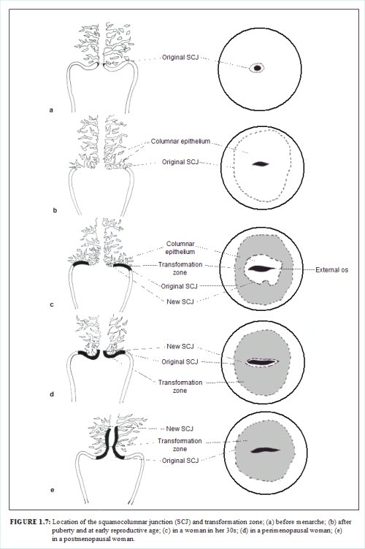
Squamo-columnar junction of the cervix
A - Before menarche
B - After puberty and early
menarche (ectropion)
C - Third decade
D - Premenopausal period
E - menopausal period
A
Oestrogen activity
B
C
D
E

Slide 5
Squamo-columnar transformation zone of the cervix
The area of the cervix where squamous
metaplasia occurs
Almost all manifestations of cervical carcinogenesis occur in this zone
Columnar epithelium
Transformation zone
External OS
Original squamo-columnar junction
New SCJ

Slide 6
Squamous metaplasia of the cervix
Normal edocervical columnar epithelium is protected by mucin
In the areas of ectropion,
- columnar cells get exposed to the acidity
of the vagina
- columnar cells get damaged and gradually
replaced by squamous epithelium

Slide 7
Squamous metaplasia of the cervix
How does squamous metaplasia occur?
There are sub-columnar cells called
“reserve cells” - morphology similar to basal
cells of the squamous epithelium
In response to vaginal acidity , reserve cells
- undergo hyperplasia and
- differentiate into squamous cells

Slide 8
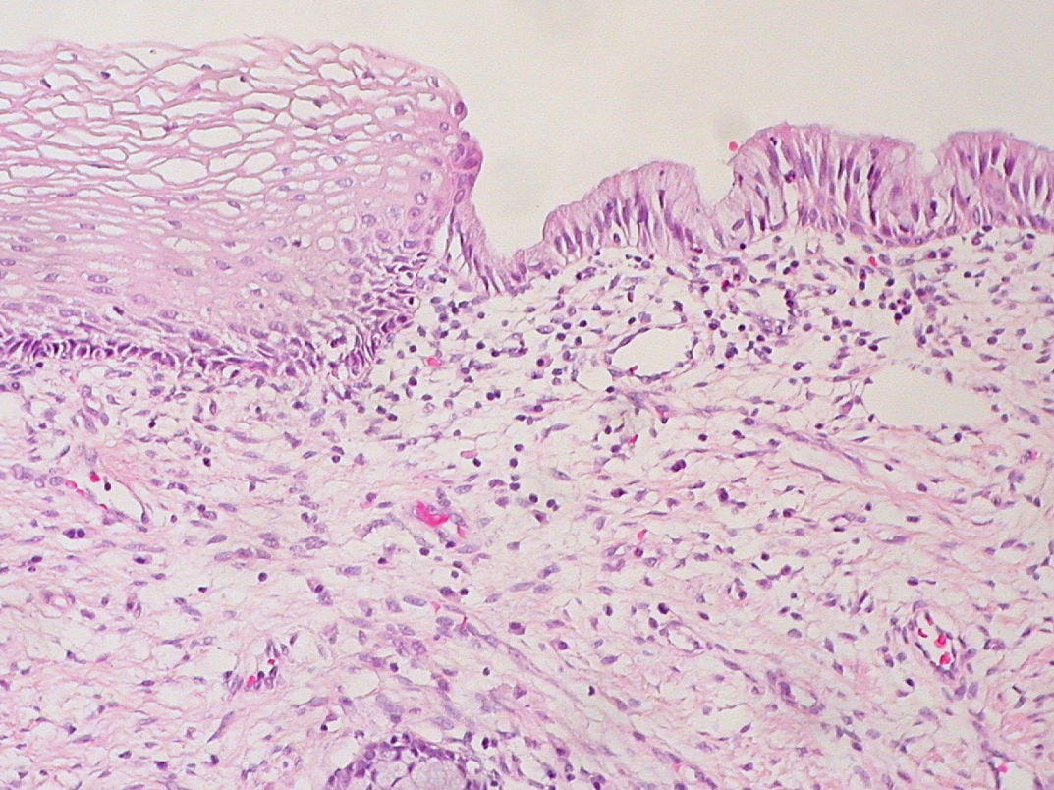
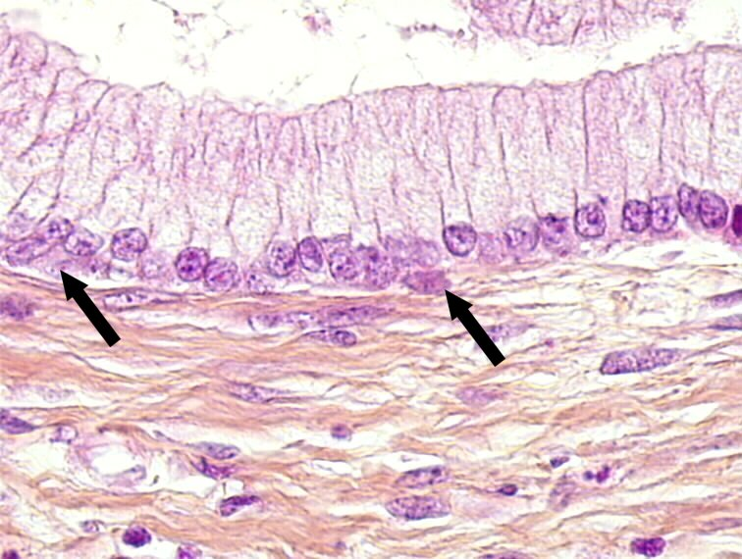
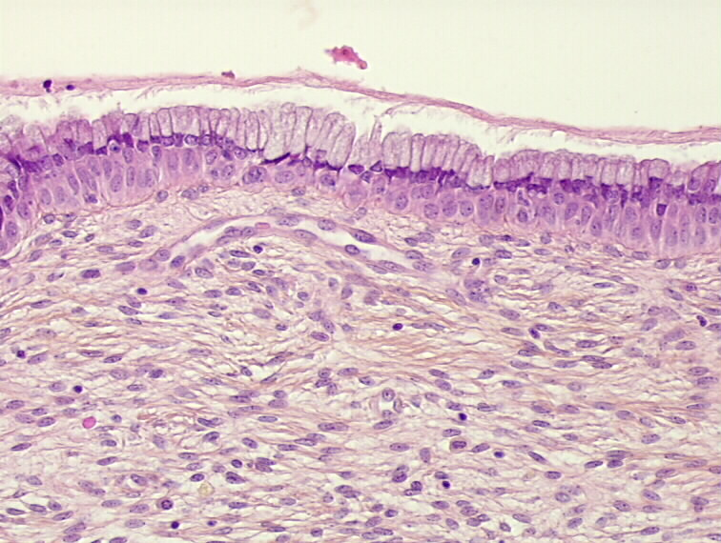
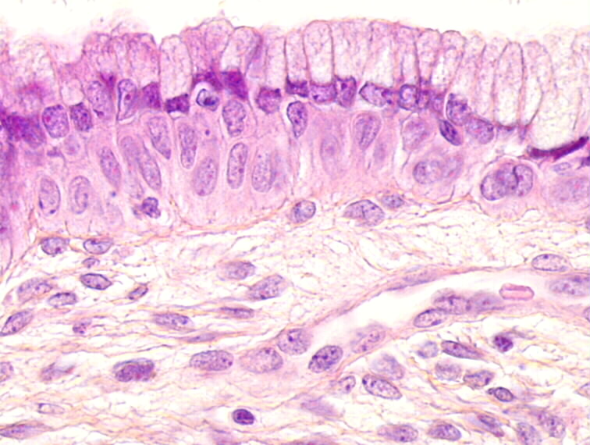
Squamo-columnar junction
Columnar epithelium of the endocervix
Squamous epithelium
Columnar epithelium
Reserve cells
H&E stain
H&E stain
Reserve cell hyperplasia
H&E stain – Low power view
H&E stain – High power view

Slide 9
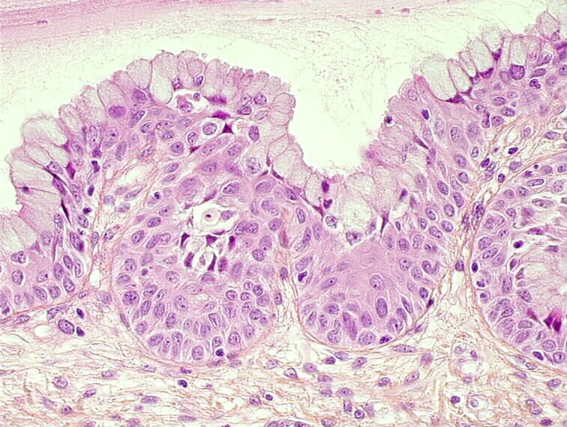
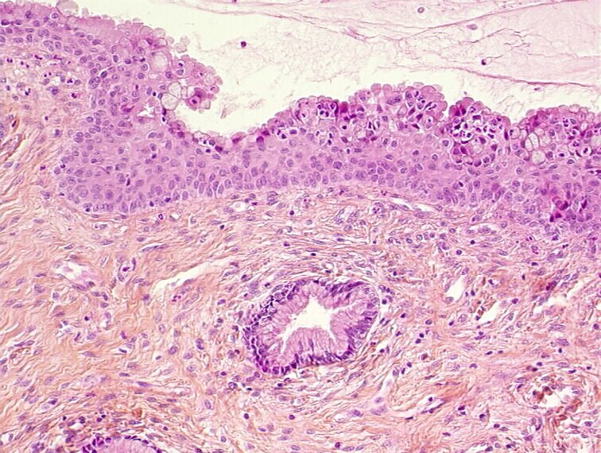
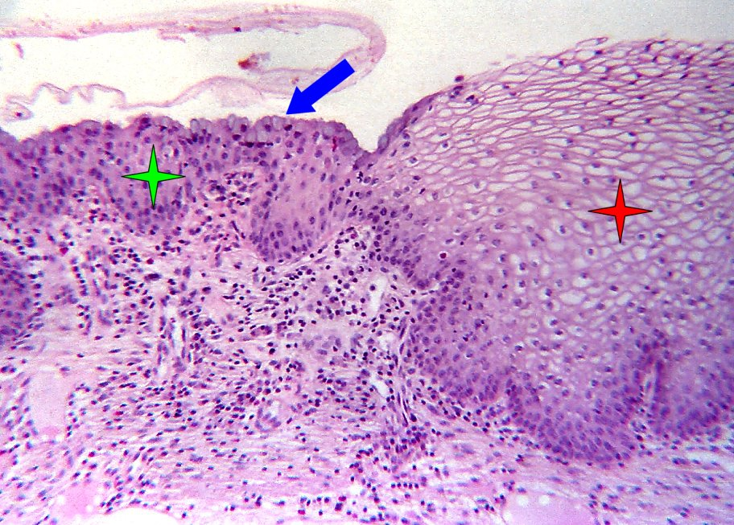
Immature squamous cell metaplasia
Squamous cell metaplasia
Remaining endocervical cells
Normal squamous epithelium
Metaplastic squamous epithelium

Slide 10
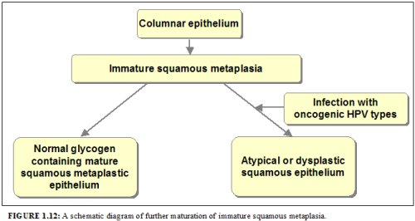

Slide 11
HPV infection of the lower female genital tract
Extremely common
Most are asymptomatic
High peak of prevalence around 20 years of age
With the development of host immunity , most are eliminated from the body
Persisting infection is high with high risk oncogenic types

Slide 12
Human papilloma virus (HPV) and lower female genital tract
“Low-risk” HPV types - type 6 and 11
(also 40,42,43,44,54,61,70, 72, 81,CP6108)
Associated with condylomata
“High-risk”/carcinogenic HPV types - type16 and 18
(Also 31,33,35,39, 45,51,52,56,58, 59,68,73,82)
Associated with carcinoma

Slide 13
Physical state of the virus
- In cancers, viral DNA is integrated into the host DNA
- In condylomata and most precancerous lesions,
present as free (episomal ) viral DNA
HPV infect the immature metaplastic cells in the
transformation zone/ areas where epithelial damage
has occurred
HPV replicate in mature squamous epithelium
resulting in cytopathic effects

Slide 14
HPV related cytopathic changes
Also known as koilocytosis/ koilocytic atypia
Disrupt the keratin matrix of squamous
- Sharply outlined perinuclear vacuolation
- Densely stained peripheral cytoplasm
- Enlarged nuclei with undulating membrane
- Binucleation and multinucleation

Slide 15
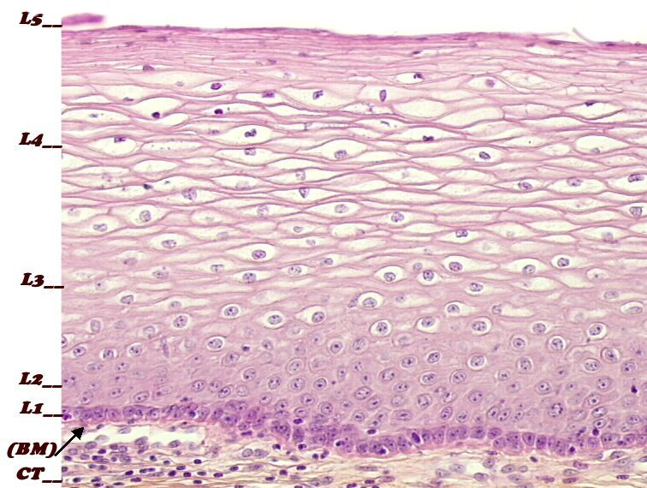
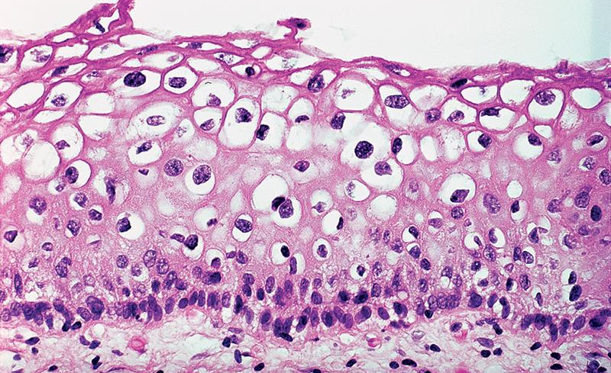
HPV related cytopathic changes
Note : Nuclear changes - variation in size and shape
- enlargement
- hyperchromasia
Cytoplasmic changes - perinuclear halo

Slide 16
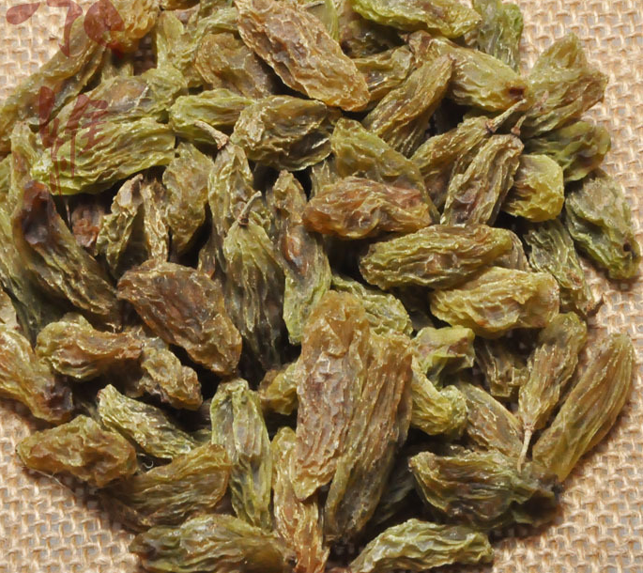
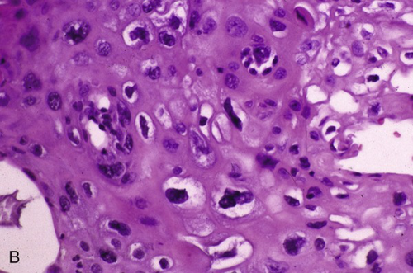
Raisins
Raisinoid nuclei

Slide 17
Cervix - Dysplasia Other investigations
Insitu hybridization test detects HPV DNA
Intense staining with high viral load
Immunostaining for Ki-67
Marker of cellular proliferation
P16 - Cell cycle regulatory protein
- Overexpression

Slide 18
HPV associated conditions of the cervix
Benign conditions
Condyloma acuminatum
Premalignant lesions
Squamous intraepithelial lesion
Malignant neoplasms
Squamous cell carcinoma
Adenocarcinoma
Neuroendocrine carcinoma

Slide 19
Dysplasia of the cervix - Classification
Oldest
Mild dysplasia, moderate dysplasia
Severe dysplasia (carcinoma in situ)
Then simplified as, cervical intraepithelial neoplasia/CIN CIN I, CIN II, CIN III
With regard to the treatment options, now use
- Low grade squamous intraepithelial lesion/ LSIL (CIN I )
- High grade squamous intraepithelial lesion/ HSIL (CIN II and CIN III)

Slide 20
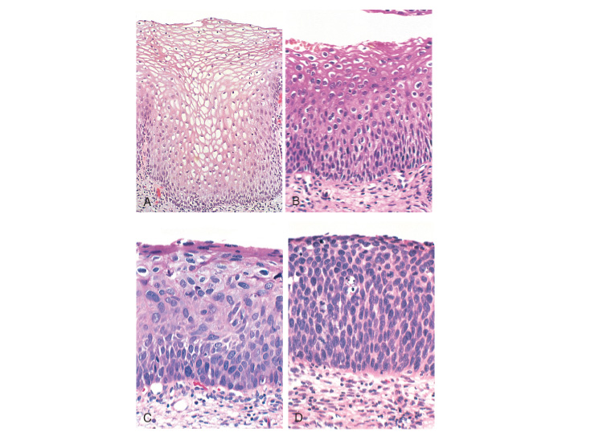
CIN and SIL
LSIL HSIL
Normal CIN I CIN II CIN III

Slide 21
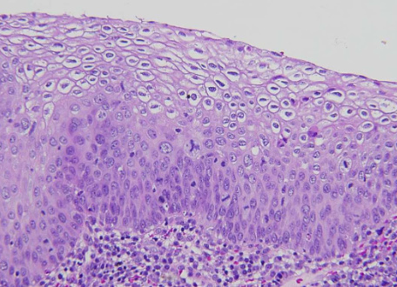
Cervix - Dysplasia Microscopic changes
Lack of maturation
Nuclear crowding and loss of polarity
Pleomorphism
Increased N/C ratio
Irregular nuclear outlines
Hyperchromatic nuclei
- coarse nuclear chromatin
Mitotic activity
- Increased and present
above the basal layer
+/- abnormal mitoses
Normal
Dysplastic epithelia

Slide 22
SIL
Behaviour of the precursor lesions is complex
Lowest grade - Most likely do not progress to carcinoma
Greater degree of cellular atypia - Greater risk of
developing carcinoma
Not all lesions begin as low grade lesions
May begin at any point depending on the viral and
host factors
Rate of progression - not uniform

Slide 23
Pap smear/ Pap test
CIN may be asymptomatic for years
Shed abnormal squamous cells
- Basis for the screening test / PAP smear test
Using spatula/ a brush transformation zone of the cervix is circumferentially scraped
Cytological preparations of exfoliated cells
- Conventional PAP smears
- Thin prep preparation

Slide 24
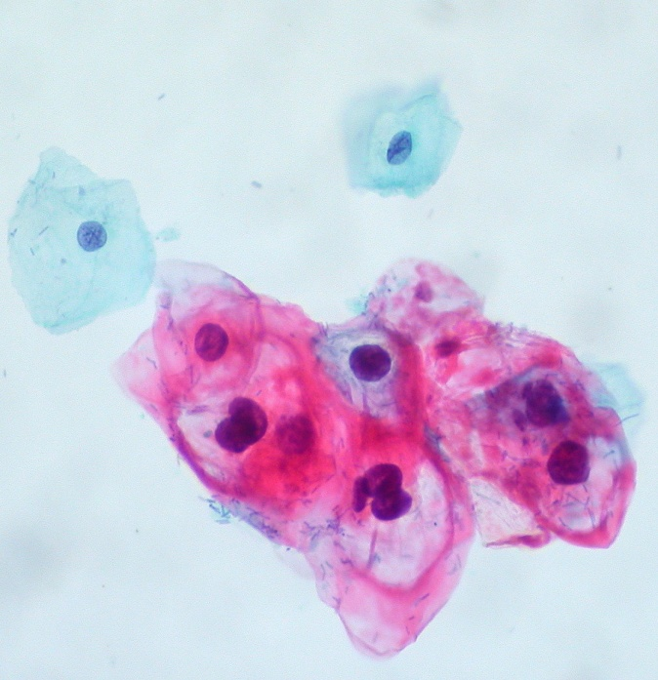
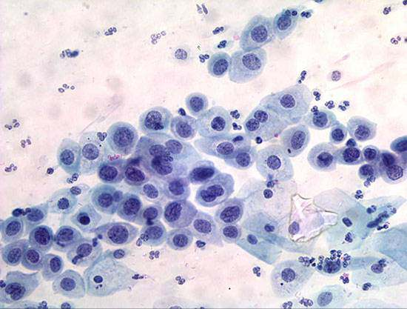
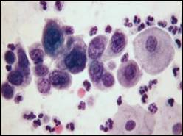
Pap smear/ Pap test
Cells are smeared on a slide/ spun down onto a slide
Stained with Papanicolaou method
CIN I CIN II CIN III

Slide 25
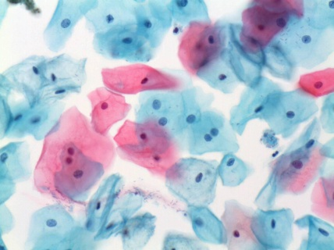

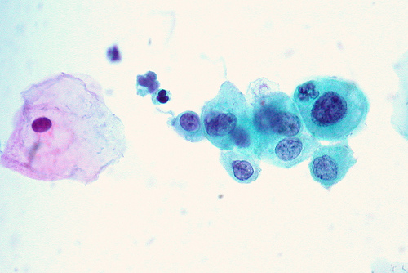
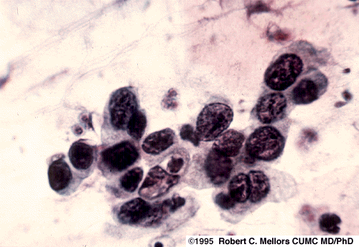
CIN and SIL
LSIL HSIL
Normal CIN I CIN II CIN III
PAP smears

Slide 26
Cervical carcinoma
Squamous cell carcinoma (SCC)
Most common histological type
HSIL - immediate precursor
Adenocarcinoma
Develop from adenocarcinoma insitu
Others
Adenosquamous carcinoma
Neuroendocrine carcinoma
All are caused by high oncogenic risk HPVs

Slide 27
Risk factors for cervical carcinoma
Multiple sexual partners
Male partner with multiple sexual partners
Young age at first intercourse
High parity
Persistent infection with high oncogenic risk HPVs
Immunosupppression
Certain HLA subtypes
Oral contraceptives - increase the risk
Use of nicotine – An important co-factor

Slide 28
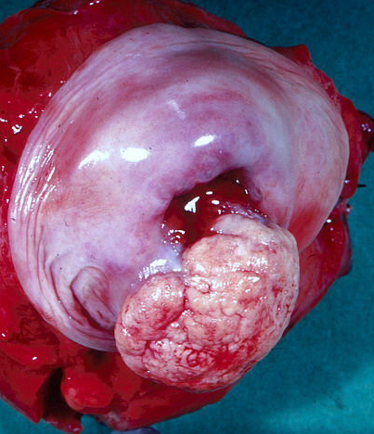
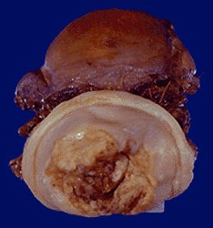
Cervical SCC - Macroscopy
Fungating/ exophytic growth
Ulcerative growth

Slide 29
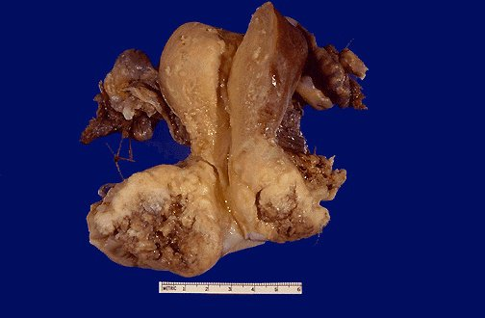
Cervical SCC - Macroscopy
Infiltrative type of tumour
Cut surface
- Solid, fleshy and
friable tumour
- Necrosis and
- Haemorrhage

Slide 30
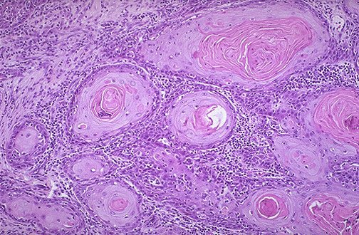
Cervical SCC - Microscopy
Ketatinizing/ well differentiated SCC

Slide 31
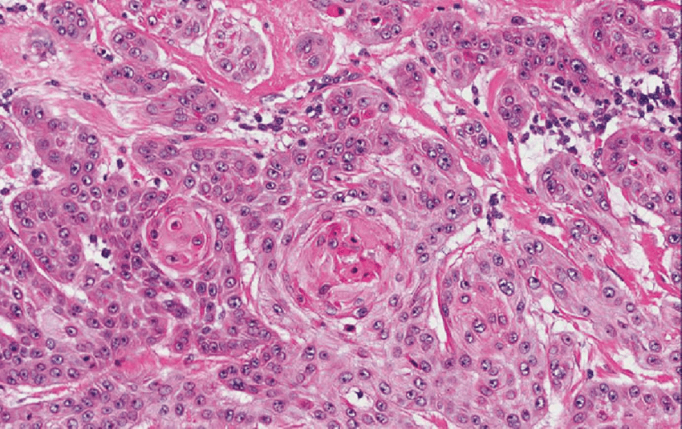
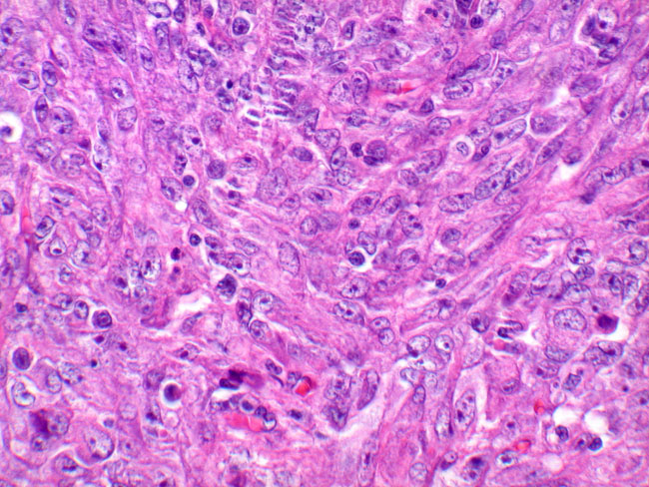
Well differentiated SCC
Moderately differentiated SCC
Poorly differentiated SCC

Slide 32
Cervix - SCC
Spread and metastasis
Direct
Vagina
Endometrium and myometrium
Parametrium
Adjoining structures - lower ureter, bladder , rectum
Lymphatic - Paracervical and external iliac nodes
Haematogenous – Lung, bones etc.

Slide 33
Lower female genital tract Inflammatory conditions
Oestrogen maturates the squamous epithelium of the cervix and vagina with formation of intracellular glycogen
When these cells are shed into vagina , provides a medium for bacterial growth
Lactobacilli dominate the normal vaginal flora
- Produce lactic acid and suppress the growth of
pathogenic organisms
- At low pH, produce H2O2 which is bacteriotoxic

Slide 34
Lower female genital tract Inflammatory conditions
Clinically insignificant mild inflammation is present in all women
Conditions that causes high vaginal pH,
eg. vaginal bleeding, sexual intercourse, antibiotics
decrease H2O2 production by lactobacilli
Facilitate the growth of pathogenic bacteria

Slide 35
Lower female genital tract Inflammatory conditions
Tissue reaction patterns and the presence of organisms help to recognize the presence of infection
Lower genital tract infection may be associated with
Upper genital tract disease
Infections during pregnancy
May transmit sexually

Slide 36
Cervix - Inflammatory conditions
Acute and chronic cervicitis
Acute inflammation - Neutrophil predominance
Chronic inflammation
Mononuclear cell infiltrate- lymphocytes,plasma cells
Chronic cervicitis may be associated with
- erosion and ulceration of the epithelium
- granulation tissue formation and
- regenerative changes of the epithelium

Slide 37
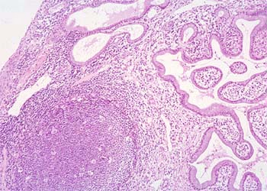
Chlamydia trachomatis infection
- lymphoid germinal centres and
- prominent plasmacytic infiltrate
H& E stain

Slide 38
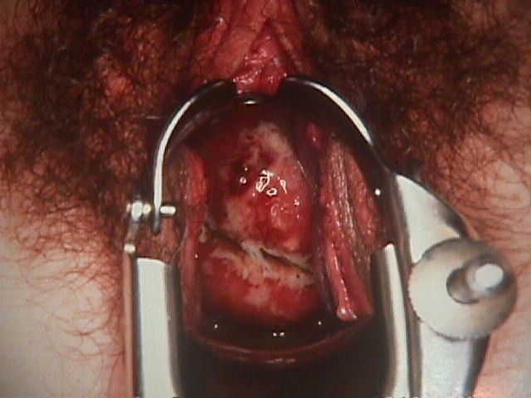
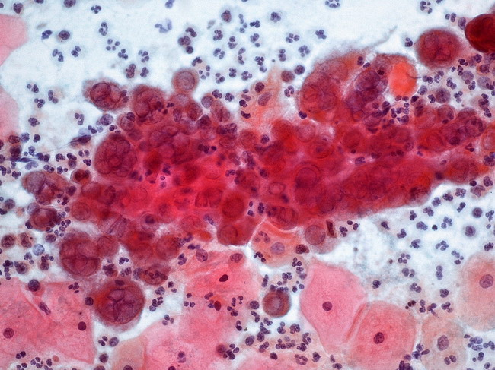
Herpes simplex virus infection
- ulceration
- intranuclear inclusions in the epithelial cells
- lymphocytic infiltrate
HSV intranuclear inclusions– Pap smear
Speculum examination
- Ulceration of the cervix

Slide 39
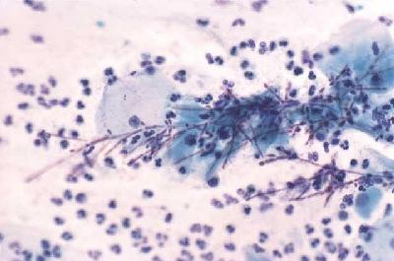
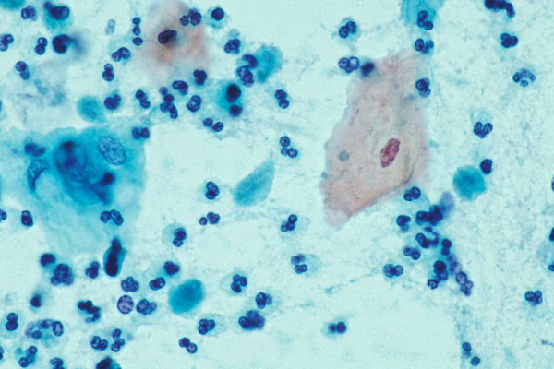
Candida
Note: Candida hyphae
Candida infection - Pap smear
Trichomonas vaginalis
Trichomonas vaginalis - Pap smear

Slide 40
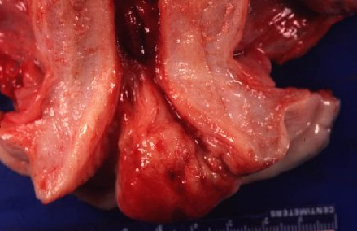
Cervix - Benign endocervical polyps
Clinical presentation
- Irregular vaginal spotting/ bleeding
- Larger polyps – “lump at vulva”

Slide 41
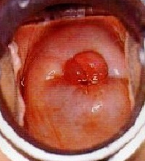
Cervix - Benign endocervical polyps
Macroscopy
Soft to firm polypoidal lesion
pink brown/ grey colour
Outer surface - Smooth/ eroded/ ulcerated
Cut surface - Oedematous /myxoid

Slide 42
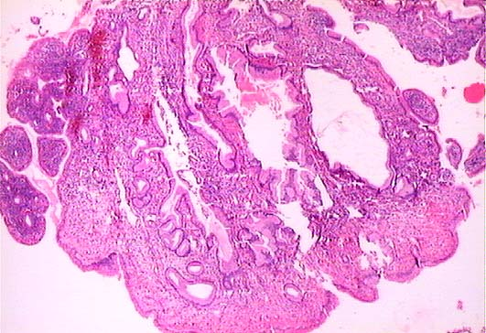
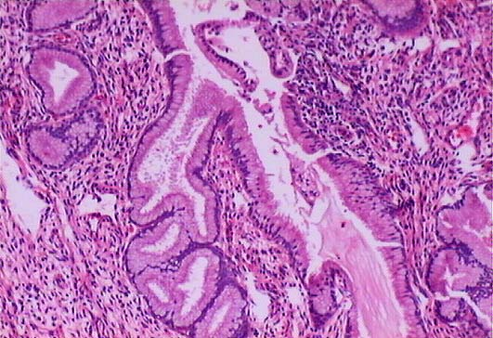
Microscopy
- dilated, mucus-secreting endocervical glands
+/- inflammation , squamous metaplasia

Slide 43
Summary
Now you should be able to
Describe the pathogenesis of human papilloma virus (HPV) related premalignant and malignant lesions of the cervix
Describe the microscopy of dysplasia of the cervix
Describe the morphology of carcinoma of the cervix
Briefly describe the non-neoplastic conditions of the cervix

Slide 44
Reading assignments
Oncogenic effects of HPV
Vaccination against HPV

Slide 45
Vulva Vagina

Slide 46
Vulva
Premalignant lesions
Vulvar Intraepithelial Neoplasia (VIN)
Malignant neoplasms (Uncommon)
Squamous cell carcinoma (commonest)
Some are associated with high risk HPV
Others are associated with squamous cell hyperplasia
and lichen sclerosus
Basal cell carcinoma
Adenocarcinoma
Melanoma

Slide 47
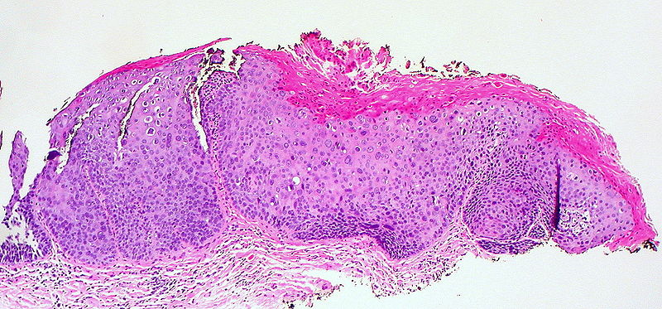
Vulvar intraepithelial neoplasia (VIN)
Note: Atypical squamous epithelial cells involving the full thickness of the epithelium
loss of polarity
Cellular pleomorphiam
Mitotic figures present above the basal layer
- No stromal invasion

Slide 48
Vulvar intraepithelial neoplasia (VIN)

Slide 49
Vagina
Premalignant lesions
Vaginal Intraepithelial Neoplasia
Malignant neoplasms - Uncommon
Squamous cell carcinoma
Most are associated with high oncogenic risk HPVs
Greatest risk factor - previous CA cervix or CA vulva
Embryonal rhabdomyosarcoma (sarcoma botryoides)
Uncommon tumour
Infants and children < 5 years

